Slide 1
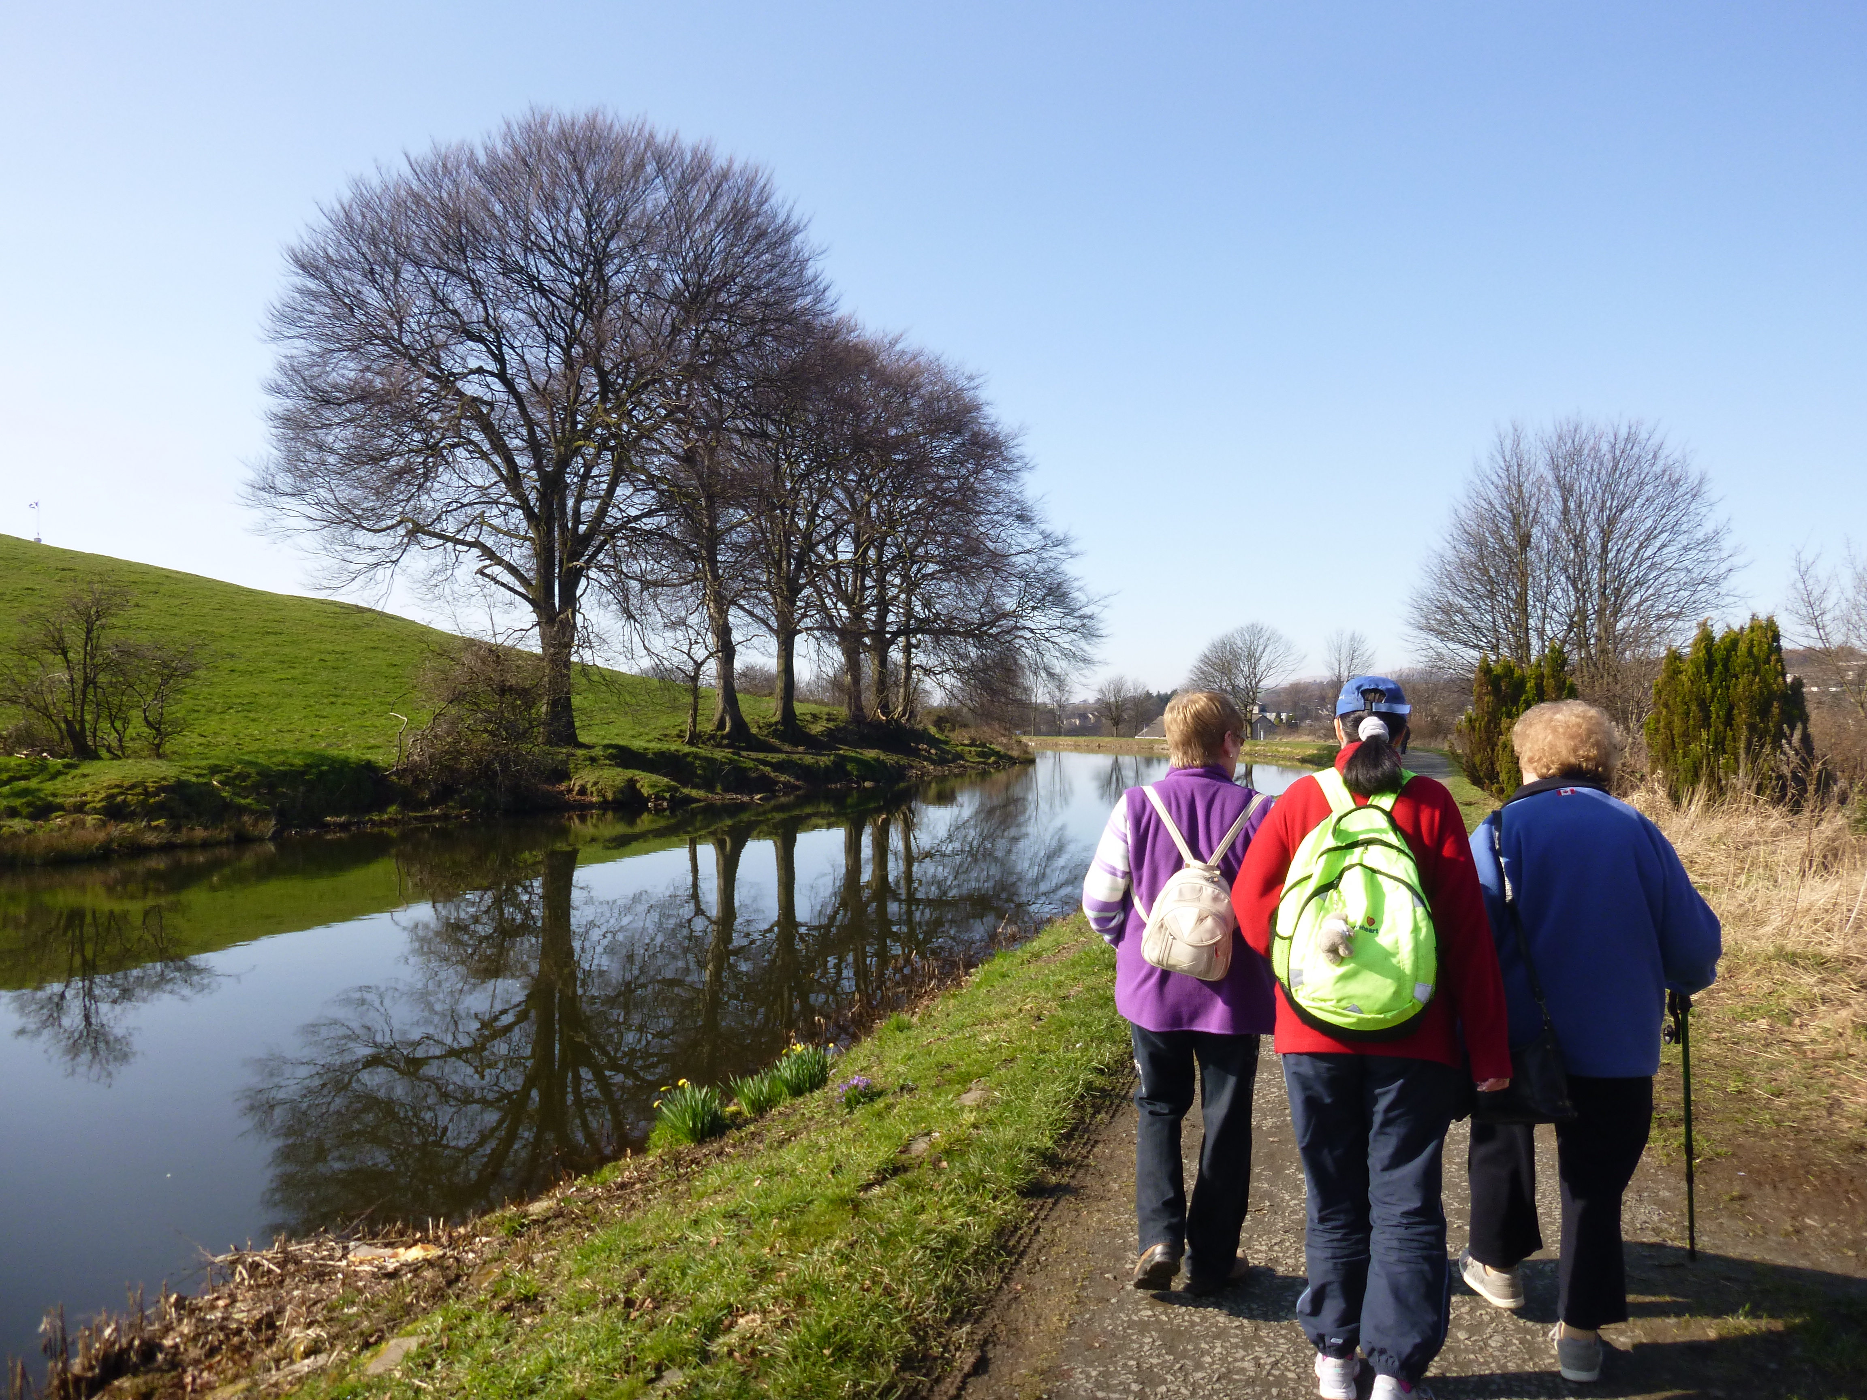
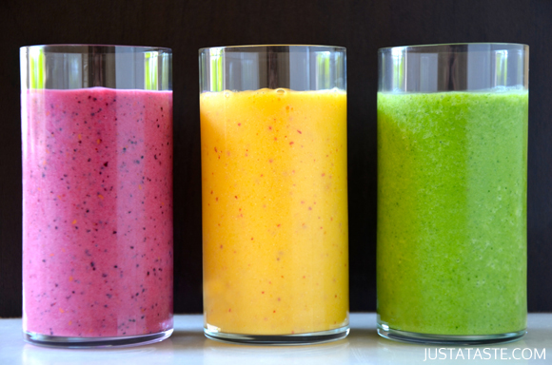
Get in shape with
Braveheart
Take steps towards your ideal weight and feel great by
taking part in Braveheart’s free weight
management sessions
Venue: Braveheart Office
Falkirk Community Hospital
Thursday Morning Sessions: 10-11am
Thursday Evening Sessions 5.30-6.30pm
Starting from 18th Feb for 8 weeks
Text or call Eva on: 07957927450

